Slide 1
IT304 Computer Networks
Week 9-Lec1_Router internals

Slide 2
Router Components

Slide 3
How Router Forwards Packets

Slide 4
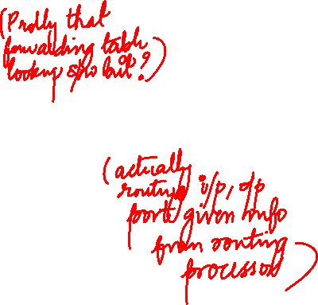
Router architecture overview
high-level view of generic router architecture:
routing, management
control plane (software)
operates in millisecond
time frame
routing
processor
forwarding data plane (hardware) operates in nanosecond timeframe
high-speed
switching
fabric
router input ports
router output ports

Slide 5


Input port functions
lookup,
forwarding
queueing
line
termination
link
layer
protocol
(receive)
switch
fabric
physical layer:
bit-level reception
Datagram
decentralized switching:
using header field values, lookup output port using forwarding table in input port memory (“match plus action”)
goal: complete input port processing at ‘line speed’
input port queuing: if datagrams arrive faster than forwarding rate into switch fabric
link layer:
e.g., Ethernet
(chapter 6)
Frame
Notes:
Green box is a physical layer responsible for receiving bit level transmission. Copper, fiber wireless.
Link layer in blue – bit assemble into Ethernet frame. We will discuss this in details in chapter 6.
But most critical one, is here. Lookup, forwarding function. Lookup and forward is “Match plus action” behavior.
GOAL – processing at “line speed”, otherwise, buffer will be full and packet will be lost

Slide 6

Input port functions
Smallest packet 64 byte on a 10Gbps link
T_{r}=51.2nsec
Too fast for software :
Implementation at the Hardware/Chip level
lookup,
forwarding
queueing
line
termination
link
layer
protocol
(receive)
switch
fabric
physical layer:
bit-level reception
decentralized switching:
using header field values, lookup output port using forwarding table in input port memory (“match plus action”)
destination-based forwarding: forward based only on destination IP address (traditional)
generalized forwarding: forward based on any set of header field values
link layer:
e.g., Ethernet
(chapter 6)

Slide 7
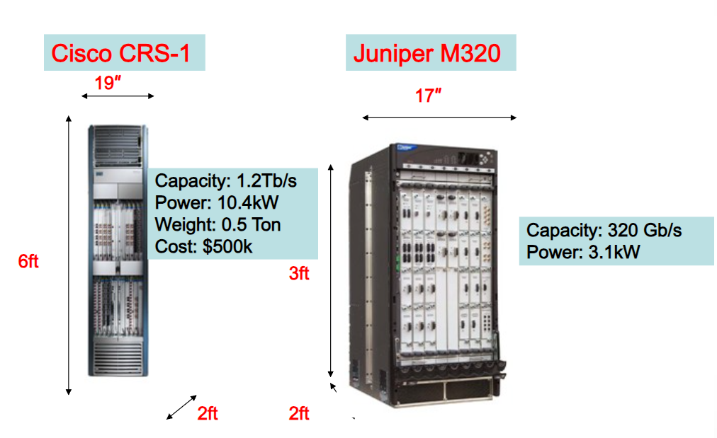
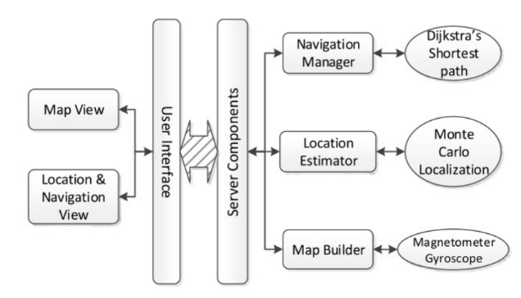
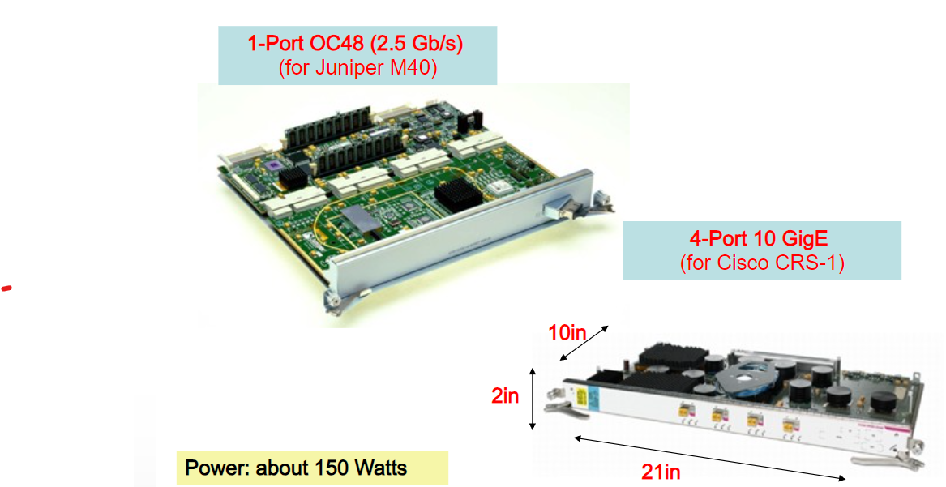

Slide 8
Switching fabrics
transfer packet from input link to appropriate output link
switching rate: rate at which packets can be transfer from inputs to outputs
often measured as multiple of input/output line rate
N inputs: switching rate N times line rate desirable
R
(rate: NR, ideally)
R
. . .
high-speed
switching
fabric
. . .
N input ports
N output ports
R
R

Slide 9
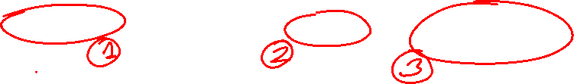
Switching fabrics
transfer packet from input link to appropriate output link
switching rate: rate at which packets can be transfer from inputs to outputs
often measured as multiple of input/output line rate
N inputs: switching rate N times line rate desirable
three major types of switching fabrics:
memory
memory
bus
interconnection
network

Slide 10
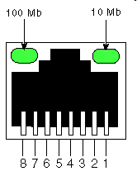
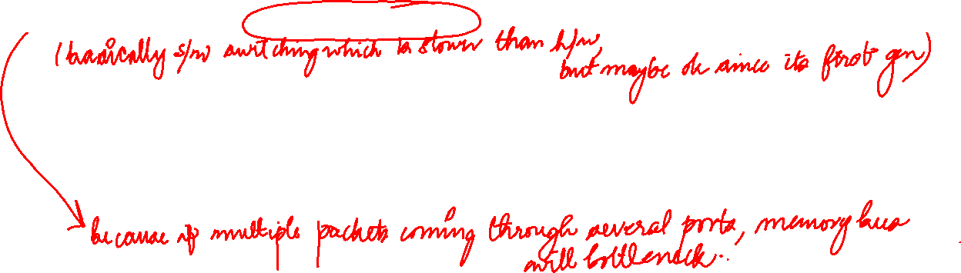
Switching via memory
first generation routers:
traditional computers with switching under direct control of CPU
packet copied to system’s memory
speed limited by memory bandwidth
input
port
(e.g.,
Ethernet)
output
port
(e.g.,
Ethernet)
memory
system bus

Slide 11
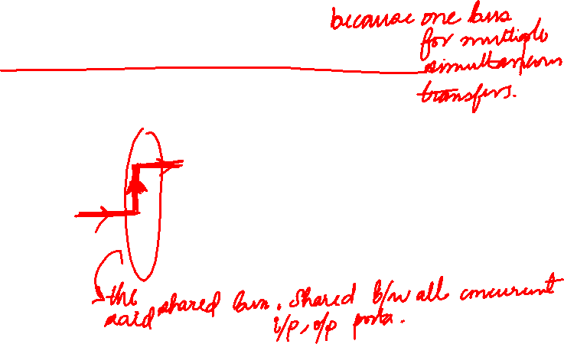
Switching via a bus
datagram from input port memory to output port memory via a shared bus
Append with label indicating Output Port
Appropriate port responds
bus contention: switching speed limited by bus bandwidth
32 Gbps bus, Cisco 5600: sufficient speed for access routers

Slide 12
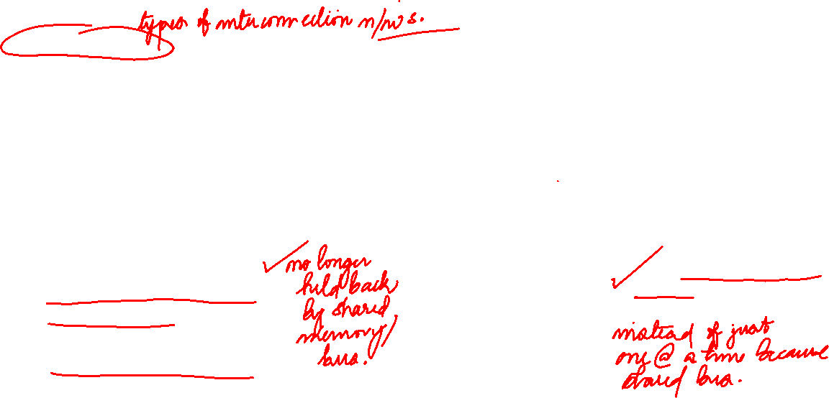
Switching via interconnection network
Crossbar, Clos networks, other interconnection nets initially developed to connect processors in multiprocessor
3x3 crossbar
multistage switch: nxn switch from multiple stages of smaller switches
3x3 crossbar
exploiting parallelism:
fragment datagram into fixed length cells on entry
switch cells through the fabric, reassemble datagram at exit
N x N switching elements
allows N simultaneous packets switched (in the best case when all packets going to different outputs)

Slide 13
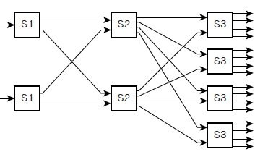

Switching via interconnection network
scaling, using multiple switching “planes” in parallel:
speedup, scaleup via parallelism
Cisco CRS router:
basic unit: 8 switching planes
each plane: 3-stage interconnection network
up to 100’s Tbps switching capacity
fabric plane 0
fabric plane 1
fabric plane 2
. . .
. . .
fabric plane 3
. . .
. . .
fabric plane 4
. . .
. . .
fabric plane 5
. . .
. . .
fabric plane 6
. . .
. . .
fabric plane 7
. . .
. . .
. . .
. . .
. . .
. . .

Slide 14
Input port queuing
If switch fabric slower than input ports combined -> queueing may occur at input queues
queueing delay and loss due to input buffer overflow!
Head-of-the-Line (HOL) blocking: queued datagram at front of queue prevents others in queue from moving forward
switch
fabric
switch
fabric
output port contention: only one red datagram can be transferred. lower red packet is blocked
one packet time later: green packet experiences HOL blocking

Slide 15

Output port queuing
datagram
buffer
queueing
switch
fabric
(rate: NR)
link
layer
protocol
(send)
line
termination
R
Buffering required when datagrams arrive from fabric faster than link transmission rate. Drop policy: which datagrams to drop if no free buffers?
Datagrams can be lost due to congestion, lack of buffers
Scheduling discipline chooses among queued datagrams for transmission
Priority scheduling – who gets best performance, network neutrality

Slide 16
Output port queuing
switch
fabric
switch
fabric
at t, packets more
from input to output
one packet time later
buffering when arrival rate via switch exceeds output line speed
queueing (delay) and loss due to output port buffer overflow!

Slide 17
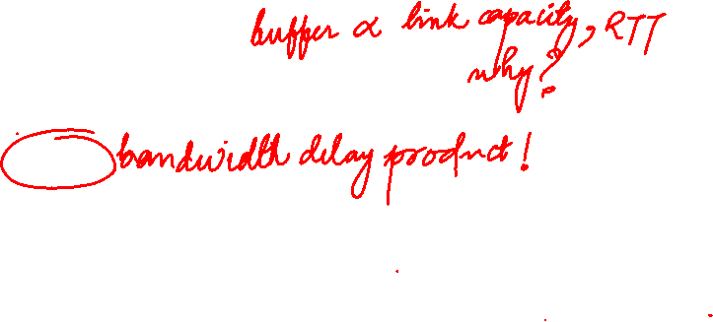
How much buffering?
RFC 3439 rule of thumb: average buffering equal to “typical” RTT (say 250 msec) times link capacity C
e.g., C = 10 Gbps link: 2.5 Gbit buffer
more recent recommendation: with N flows, buffering equal to
.
RTT C
N
but too much buffering can increase delays (particularly in home routers)
long RTTs: poor performance for real-time apps, sluggish TCP response
recall delay-based congestion control: “keep bottleneck link just full enough (busy) but no fuller”
Notes:
You might think that more buffering is a good thing. Buffering is a bit like salt—just the right amount of salt makes food better, but too much makes it inedible!

Slide 18

Buffer Management
buffer management:
drop: which packet to add, drop when buffers are full
tail drop: drop arriving packet
priority: drop/remove on priority basis
datagram
buffer
queueing
scheduling
switch
fabric
link
layer
protocol
(send)
line
termination
R
Abstraction: queue
marking: which packets to mark to signal congestion (Random Early Detection)
R
packet
departures
packet
arrivals
queue
(waiting area)
link
(server)

